Slide 1



DTDs

Slide 2


Lesson 1 – Document Type Definition
In this first lesson, Document Type Definition, you
will learn to:
Define what is meant by a DTD.
Identify the need for a DTD.

Slide 3


Definition of a DTD
It is a non XML document made up of element,
attribute and entity declarations.
It helps XML parsers to validate the XML document.

Slide 4

Need for a DTD
XML allows a user to define his/her own tag.
Standardization of elements and attributes was needed.
A DTD can define all the possible combinations and sequences for elements.

Slide 5

Structure of DTD
Element Declarations
Attribute Declarations
Entity Declarations

Slide 6

DOCTYPE Declarations 2-2
Syntax
<!DOCTYPE name_of_root_element [ internal DTD subset ]>
or
<!DOCTYPE name_of_root_element SYSTEM “URL of the
external DTD subset” >

Slide 7


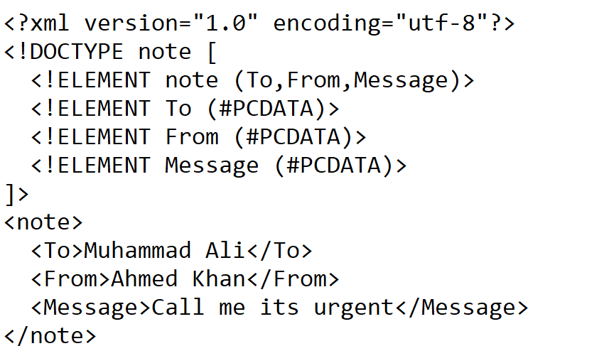
Type-1 : XML document with an Internal DTD
Example

Slide 8



Types of DTDs 1-2
DTDs can be classified as Internal or External.
External DTDs
It consists of the DTD name followed by the DTD enclosed in square brackets.

Slide 9
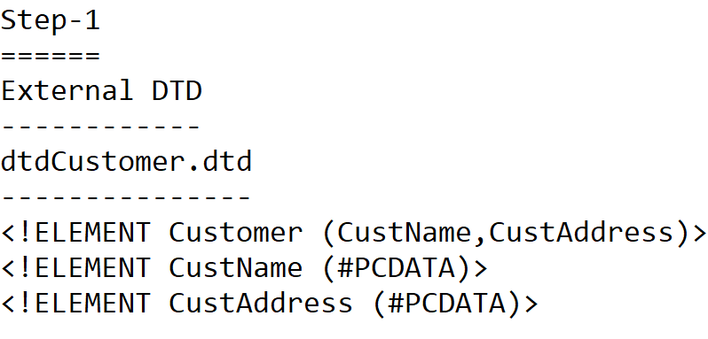
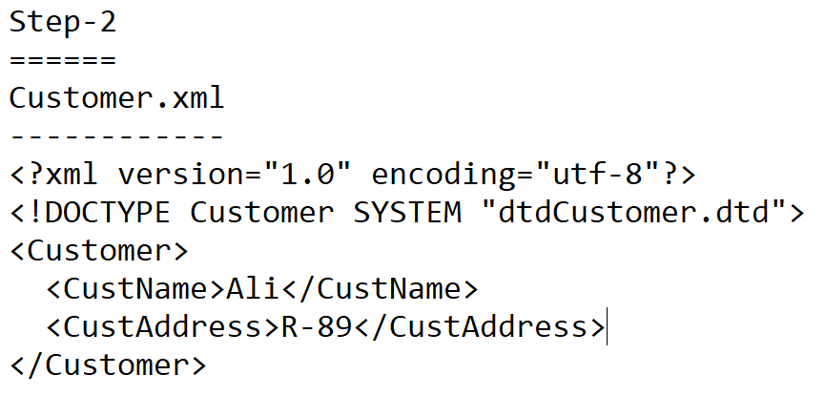
XML document with an external DTD:

Slide 10

Lesson 4 - Declarations
In this last lesson, Declarations, you will learn to:
Explain how to declare elements.
Explain how to declare attributes.
Describe entity declaration in a DTD.

Slide 11


Declaring Elements
XML elements are declared with an element declaration.
Syntax
<!ELEMENT element-name element-rule>
where,
ELEMENT is the keyword,
element-name is the name of the element,
element-rule can be one of the following: No Content, Only
Parsed Character Data, Any Contents, Children, Only One Occurrence, Minimum One Occurrence, Zero or More Occurrences, Zero or One Occurrence, Either/Or Content or Mixed Content

Slide 12

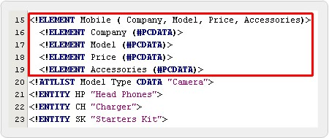
Testing XML for Validity

Slide 13

Specifying Attribute Values 1-3
Value | Description
value | Default value
#REQUIRED | Value must be included
#IMPLIED | Value does not have to be included
#FIXED | Value is fixed

Slide 14
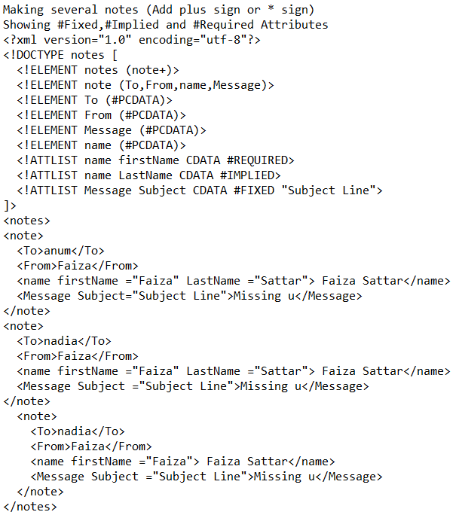

Slide 15


Entities in DTD 1-2
It is a placeholder that consists of a name and a value.
It is declared once and then repeatedly used through out the document.
Syntax
Entity declaration:
<!ENTITY entity-name “entity-value”>
Entity Reference:
&entity-name;

Slide 16


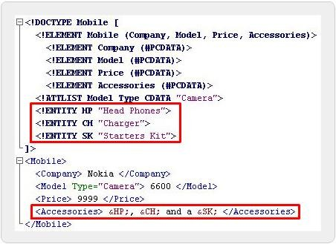
Entities in DTD 2-2
Code Snippet

Slide 17


Kinds of Entity Declarations 3-4
External Entity Declaration
A link or path to the entity value is mentioned in place of the entity value

Slide 18


Kinds of Entity Declarations 4-4
Syntax
<!ENTITY entity-name SYSTEM “URI/URL”>
<!DOCTYPE Mobile [
<!ELEMENT Mobile (Company, Model, Price, Accessories)>
<!ELEMENT Company (#PCDATA)>
<!ELEMENT Model (#PCDATA)>
<!ELEMENT Price (#PCDATA)>
<!ELEMENT Accessories (#PCDATA)>
<!ATTLIST Model Type CDATA “Camera”>
<!ENTITY HP SYSTEM “hp.txt”>
<!ENTITY CH SYSTEM “ch.txt”>
<!ENTITY SK SYSTEM “sk.txt”>
]>
<Mobile>
<Company> Nokia </Company>
<Model Type=”Camera”> 6600 </Model>
<Price> 9999 </Price>
<Accessories> &HP;, &CH; and a &SK; </Accessories>
</Mobile>
hp.txt
Head Phones ch.txt Charger sk.txt Starters Kit

